Slide 1
Problem Statement:
Build classification models to predict which employee is likely to churn and help the business to devise policies and attract back the right talent.

Slide 2
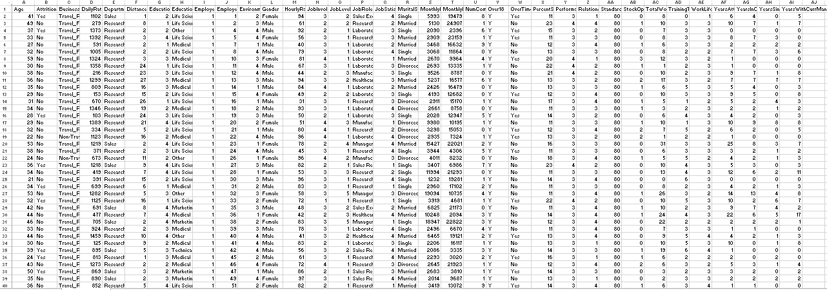

Slide 3
Data contains different attributes of an employee and the target variable Attrition.
We use this dataset to predict employee churn.

Slide 4
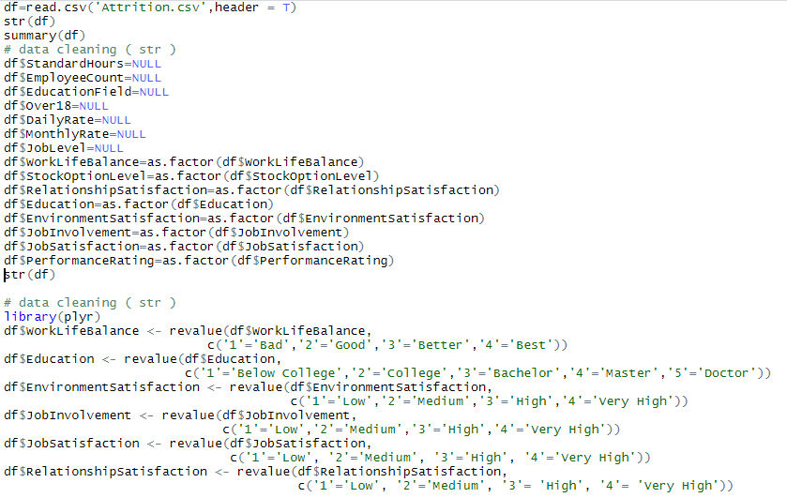

Slide 5
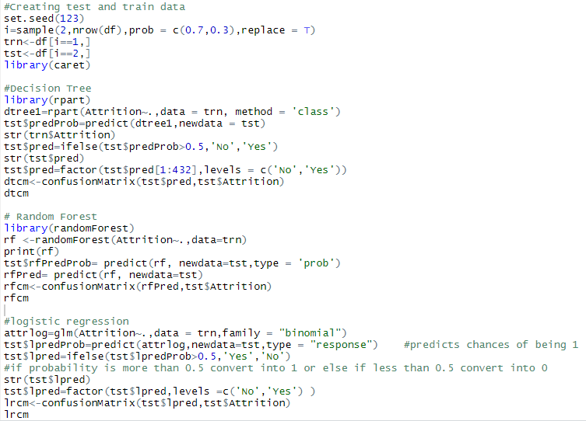

Slide 6
Confusion Matrix and Statistics
(Decision Tree)
Reference
Prediction No Yes
No 344 57
Yes 16 15
Accuracy : 0.8310
Confusion Matrix and Statistics
(Random Forest)
Reference
Prediction No Yes
No 360 62
Yes 00 10
Accuracy : 0.8565
Confusion Matrix and Statistics
(Logistic Regression)
Reference
Prediction No Yes
No 344 40
Yes 16 32
Accuracy : 0.8704

Slide 7
Hence, Logistic Regression is the best model.

Slide 8


Slide 9
There are two problems:
There are lots of features in the data set.
2. The previous model is wrongly predicting the class “Yes”.

Slide 10
Too Many Features or Attributes
Time Consuming
Low Accuracy
Consumes Resources

Slide 11
Boruta Algorithm
Feature-selection algorithm
Based on Random Forest
Working

Slide 12
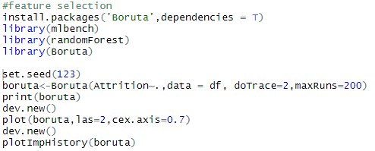

Slide 13
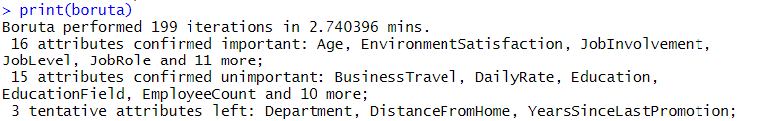

Slide 14
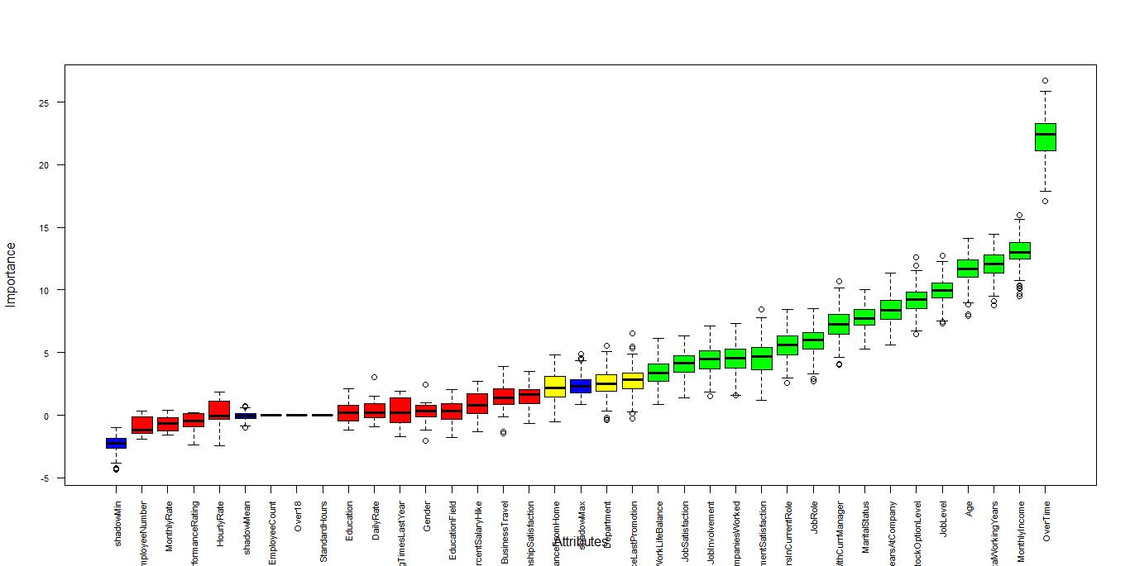

Slide 15
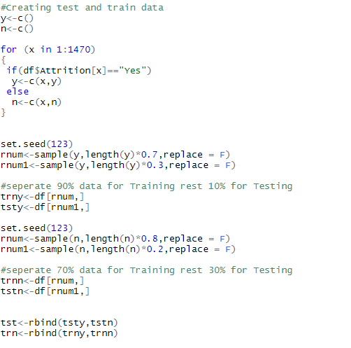

Slide 16
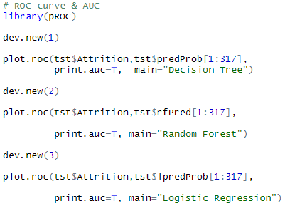

Slide 17
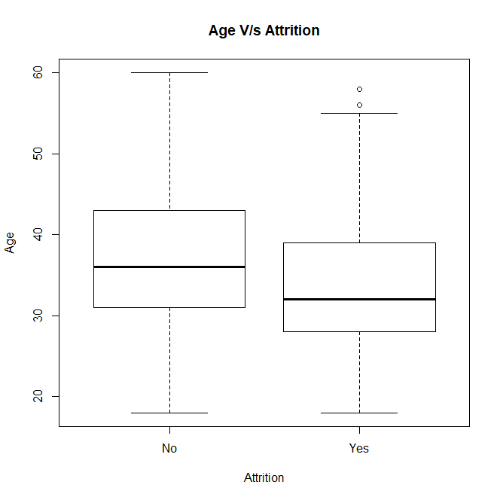

Slide 18
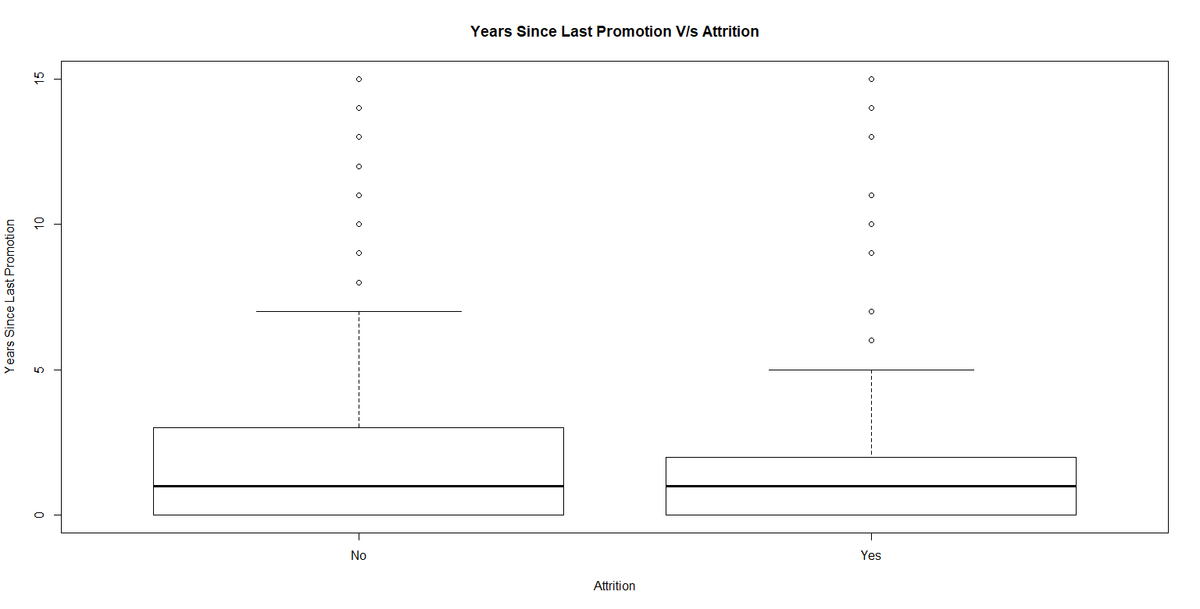

Slide 19
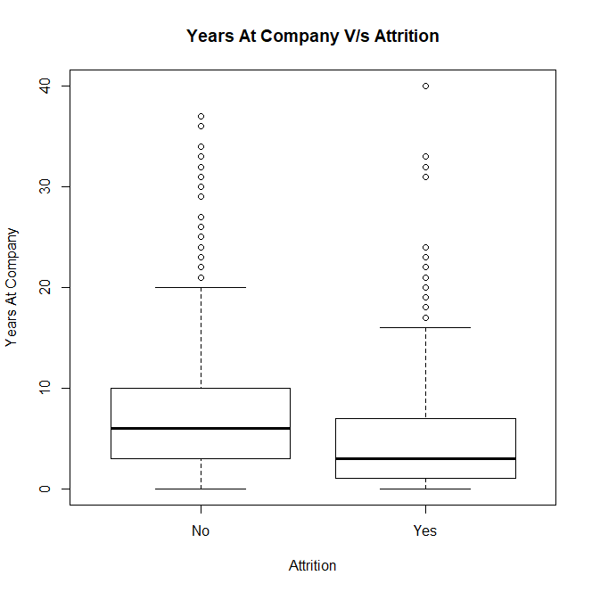

Slide 20
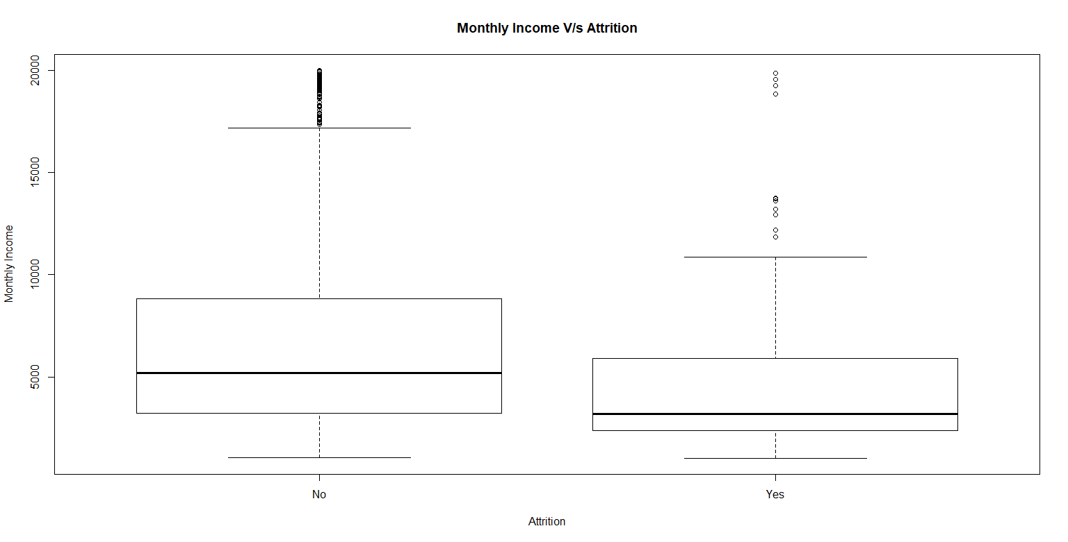

Slide 21
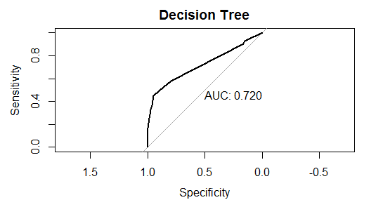
Confusion Matrix and Statistics
Reference
Prediction No Yes
No 240 48
Yes 6 23
Accuracy : 0.8297
95% CI : (0.7837, 0.8694)
No Information Rate : 0.776
P-Value [Acc > NIR] : 0.01134
Kappa : 0.3794
Mcnemar's Test P-Value : 2.414e-08
Sensitivity : 0.9756
Specificity : 0.3239
Pos Pred Value : 0.8333
Neg Pred Value : 0.7931
Prevalence : 0.7760
Detection Rate : 0.7571
Detection Prevalence : 0.9085
Balanced Accuracy : 0.6498
'Positive' Class : No

Slide 22
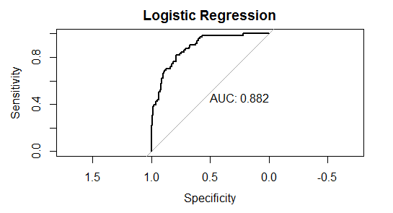
Confusion Matrix and Statistics
Reference
Prediction No Yes
No 242 49
Yes 4 22
Accuracy : 0.8328
95% CI : (0.7871, 0.8722)
No Information Rate : 0.776
P-Value [Acc > NIR] : 0.007701
Kappa : 0.3791
Mcnemar's Test P-Value : 1.505e-09
Sensitivity : 0.9837
Specificity : 0.3099
Pos Pred Value : 0.8316
Neg Pred Value : 0.8462
Prevalence : 0.7760
Detection Rate : 0.7634
Detection Prevalence : 0.9180
Balanced Accuracy : 0.6468
'Positive' Class : No

Slide 23
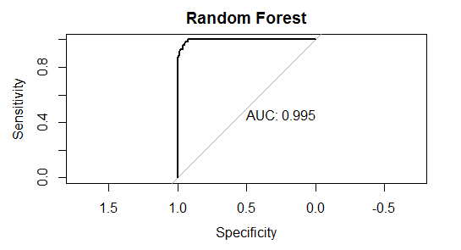
Confusion Matrix and Statistics
Reference
Prediction No Yes
No 246 11
Yes 0 60
Accuracy : 0.9653
95% CI : (0.9388, 0.9826)
No Information Rate : 0.776
P-Value [Acc > NIR] : < 2.2e-16
Kappa : 0.8944
Mcnemar's Test P-Value : 0.002569
Sensitivity : 1.0000
Specificity : 0.8451
Pos Pred Value : 0.9572
Neg Pred Value : 1.0000
Prevalence : 0.7760
Detection Rate : 0.7760
Detection Prevalence : 0.8107
Balanced Accuracy : 0.9225
'Positive' Class : No

Slide 24
Solution
Work life balance
Stock – option Level
Monthly Income
Job Satisfaction
Feed back

Slide 25
THANK YOU

